Slide 1
Assymetric CRYPTOGRAPHY
Lecture 5
Instructor:
dr. zainab abaid

Slide 2
Disadvantages of symmetric key cryptography
Problem of how to securely share a key over an insecure channel
Key explosion
No non-repudiation

Slide 3
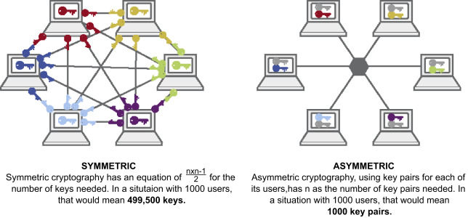
The key explosion problem in symmetric key cryptography
Notes:
Source: https://ars.els-cdn.com/content/image/3-s2.0-B9780128184271000112-u11-30-9780128184271.jpg
Prove both the formulae.

Slide 4

AsymMetric cryptography

Slide 5
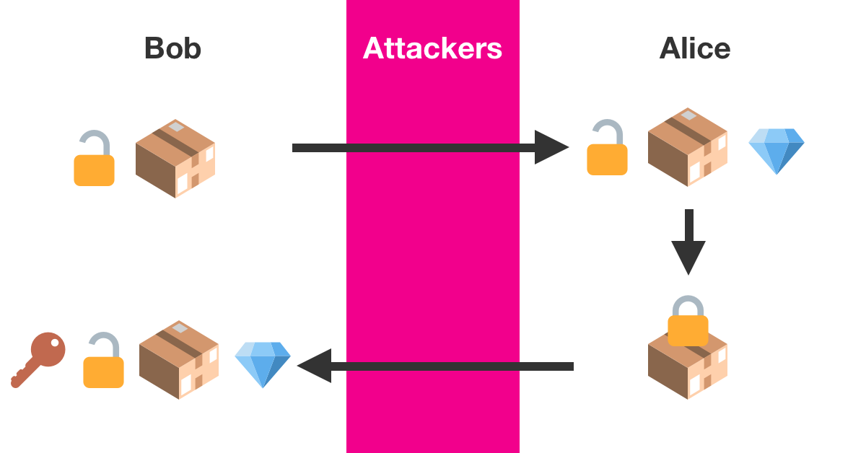
Padlock analogy
Notes:
Source: https://brilliant.org/wiki/rsa-encryption/#:~:text=RSA%20is%20an%20encryption%20algorithm,large%20numbers%20is%20very%20difficult.

Slide 6
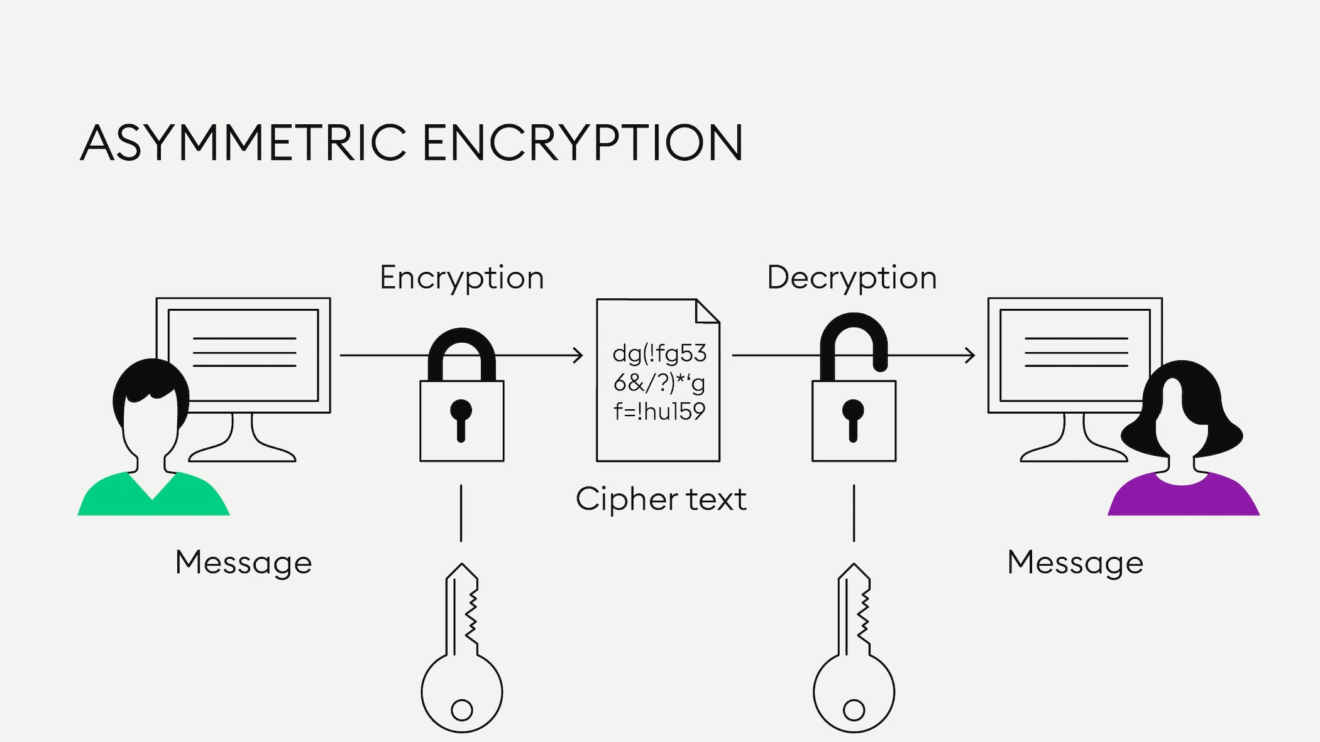
Notes:
Source: https://bitpanda-academy.imgix.net/450037a5-144d-44ef-9db1-7fe7ce1f433d/bitpanda-academy-expert-20-what-is-asymmetric-encryption-infographic.png?auto=compress%2Cformat&fit=min&fm=jpg&q=80&w=2100

Slide 7
Requirements for an asymmetric cipher
Bob needed a padlock and a key that went with that padlock. It was a lock-key pair that ensured the scheme worked.
In encryption, we just call both elements of the pair “keys” (they are just numbers), but the padlock is the public key (anyone can have it, most they can do is send you a secret using it) and its key is the private key.
Essentially we want the keys to be mathematically related such that when Alice will operate on the plaintext with the public key, and send Bob the resulting ciphertext, Bob can do some mathematical operation with the private key on that ciphertext to get the original plaintext back.
A brilliant, elegant, simple solution: RSA.

Slide 8
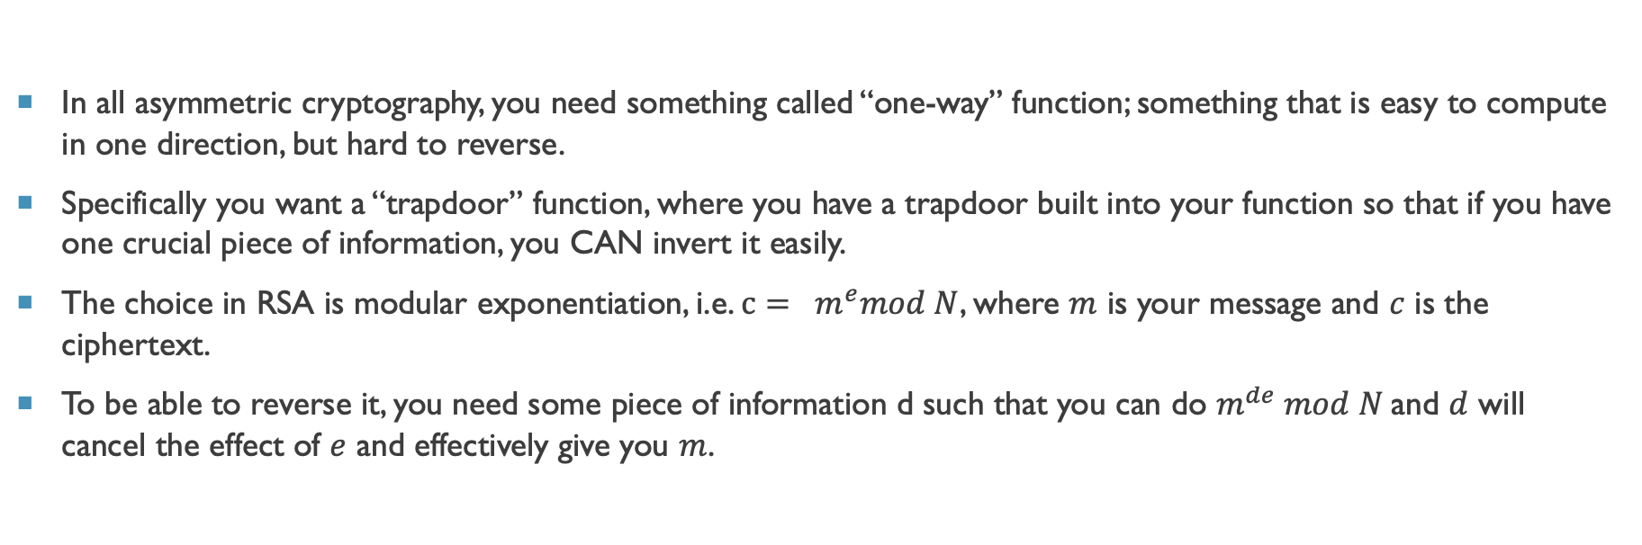
Requirements for an asymmetric cipher (2)
In all asymmetric cryptography, you need something called “one-way” function; something that is easy to compute in one direction, but hard to reverse.
Specifically you want a “trapdoor” function, where you have a trapdoor built into your function so that if you have one crucial piece of information, you CAN invert it easily.
The choice in RSA is modular exponentiation, i.e. $c= m^{e}mod N$, where $m$ is your message and $c$ is the ciphertext.
To be able to reverse it, you need some piece of information d such that you can do $m^{de} mod N$and $d$ will cancel the effect of $e$ and effectively give you $m$.

Slide 9
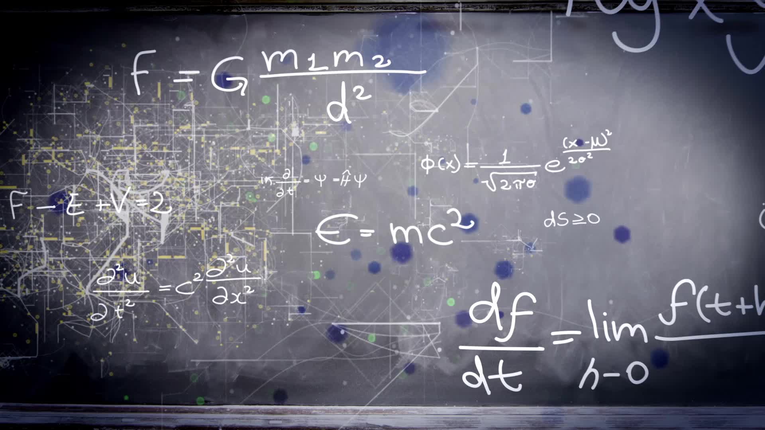
rsa
Rivest Shamir Adleman Algorithm

Slide 10
Worked example
Sender:
Has a pair of numbers, say (5,14).
Sender wants to send the letter B.
First convert B to a number (so we can do math on it); for now let’s just use its position in the alphabet, so 2.
Now, your ciphertext is simply (2^5) mod 14. Which is 4. Convert that to a letter, which would be D.
D is your ciphertext.
Receiver:
Has his own pair of numbers (11,14)
Receives D. Converts to a number.
Ciphertext = 4.
The plaintext is simply (4^11) mod 14. The exact same process the sender did, except the first number is different.
That comes out to be 2.
2 converted to letters is B, is your plaintext.
It works! But only if you can figure out where the numbers came from ☺
Notes:
How to find 4^11 mod 14? Calculators don’t necessarily have mod. If it does, use it. If not, do this workaround:
(((4^11) % 14) - the integer part of this answer) * 14; round it to the closest number.

Slide 11

The RSA algorithm (Part 1: public key generation)
Step 1:
First you pick two primes $p$ and $q$. $p$ = 2 and $q$ =. 7.
Step 2:
Then calculate a number $N=p∗q$ . This number becomes the modulus 14 in the previous example.
This number eventually becomes public. The $p$ and $q$ do not*.
Notes:
*P and Q are really hard to guess if the primes you pick are very big, which in practice they are (several hundred digits long).

Slide 12
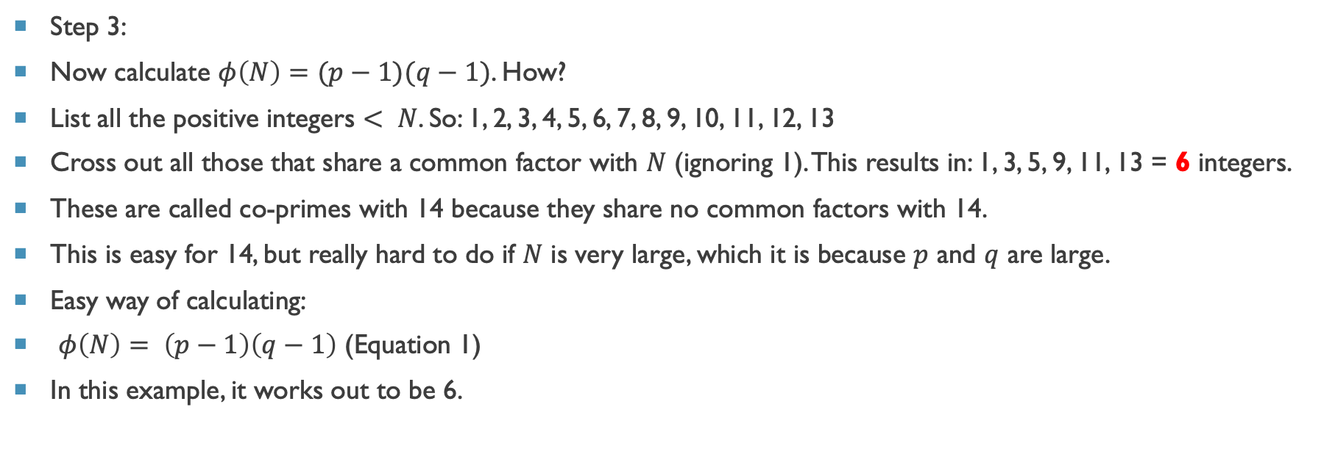
The RSA algorithm (Part 1: public key generation)
Step 3:
Now calculate $φ\left(N\right)=(p−1)(q−1)$. How?
List all the positive integers $< N$. So: 1, 2, 3, 4, 5, 6, 7, 8, 9, 10, 11, 12, 13
Cross out all those that share a common factor with $N$ (ignoring 1). This results in: 1, 3, 5, 9, 11, 13 = 6 integers.
These are called co-primes with 14 because they share no common factors with 14.
This is easy for 14, but really hard to do if $N$ is very large, which it is because $p$ and $q$ are large.
Easy way of calculating:
$φ\left(N\right)= \left(p−1\right)\left(q−1\right)$ (Equation 1)
In this example, it works out to be 6.
Notes:
*P and Q are really hard to guess if the primes you pick are very big, which in practice they are (several hundred digits long).

Slide 13
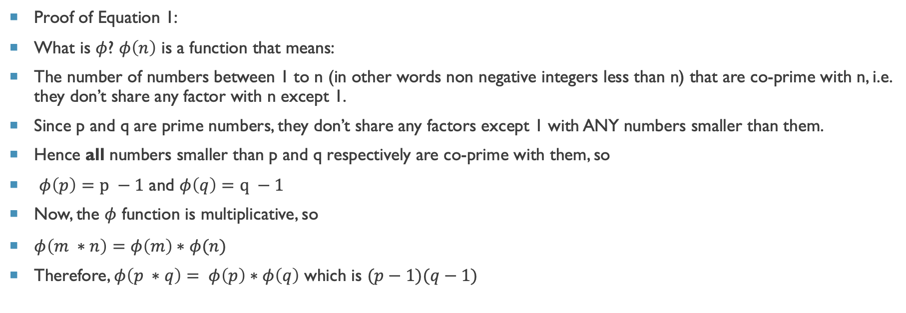
The RSA algorithm (Part 1: public key generation)
Proof of Equation 1:
What is $φ$? $φ\left(n\right)$ is a function that means:
The number of numbers between 1 to n (in other words non negative integers less than n) that are co-prime with n, i.e. they don’t share any factor with n except 1.
Since p and q are prime numbers, they don’t share any factors except 1 with ANY numbers smaller than them.
Hence all numbers smaller than p and q respectively are co-prime with them, so
$φ\left(p\right)=p −1$ and $φ\left(q\right)=q −1$
Now, the $φ$ function is multiplicative, so
$φ\left(m ∗n\right)=φ\left(m\right)∗φ(n)$
Therefore, $φ\left(p ∗q\right)= φ\left(p\right)∗φ\left(q\right)$ which is $(p−1)(q−1)$

Slide 14
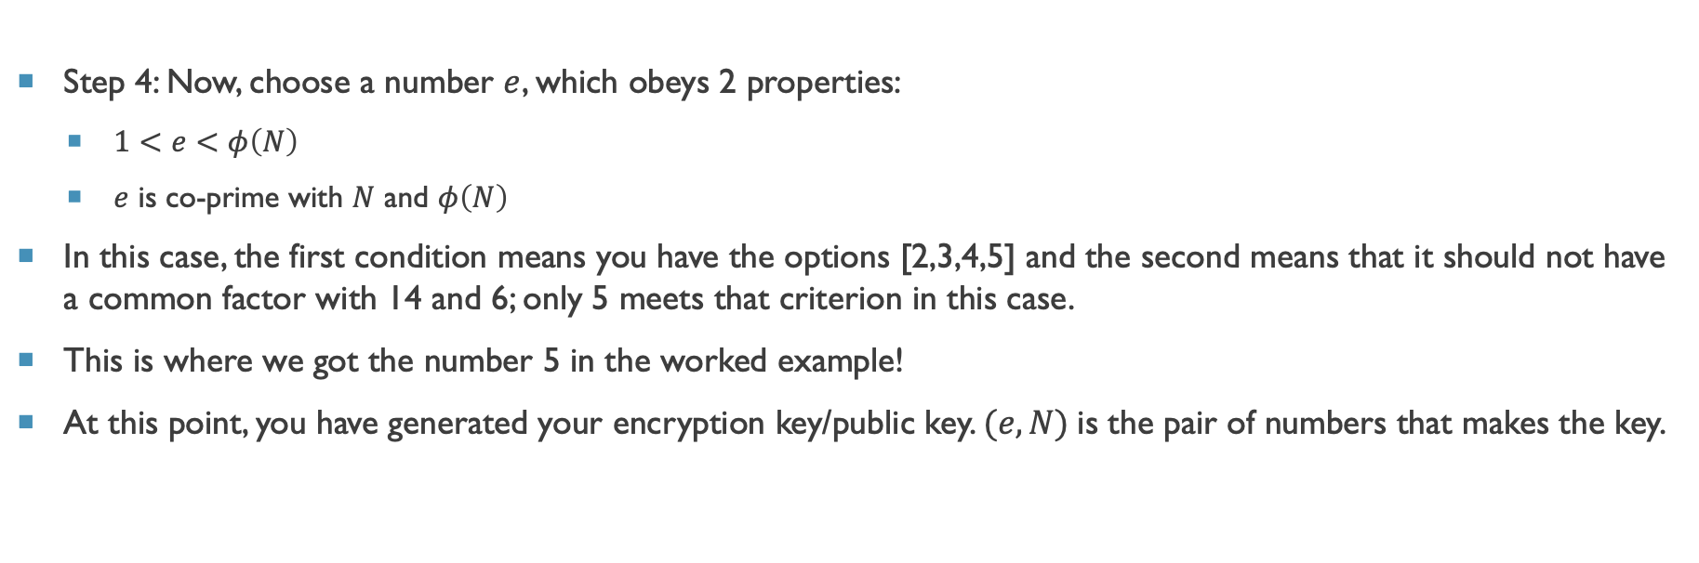
The RSA algorithm (Part 1: public key generation)
Step 4: Now, choose a number $e$, which obeys 2 properties:
$1<e<φ\left(N\right)$
$e$ is co-prime with $N$ and $φ\left(N\right)$
In this case, the first condition means you have the options [2,3,4,5] and the second means that it should not have a common factor with 14 and 6; only 5 meets that criterion in this case.
This is where we got the number 5 in the worked example!
At this point, you have generated your encryption key/public key. $(e, N)$is the pair of numbers that makes the key.
Notes:
*P and Q are really hard to guess if the primes you pick are very big, which in practice they are (several hundred digits long).
E has to satisfy these conditions so that its inverse exists.
Such an e can then satisfy euler’s theorem

Slide 15
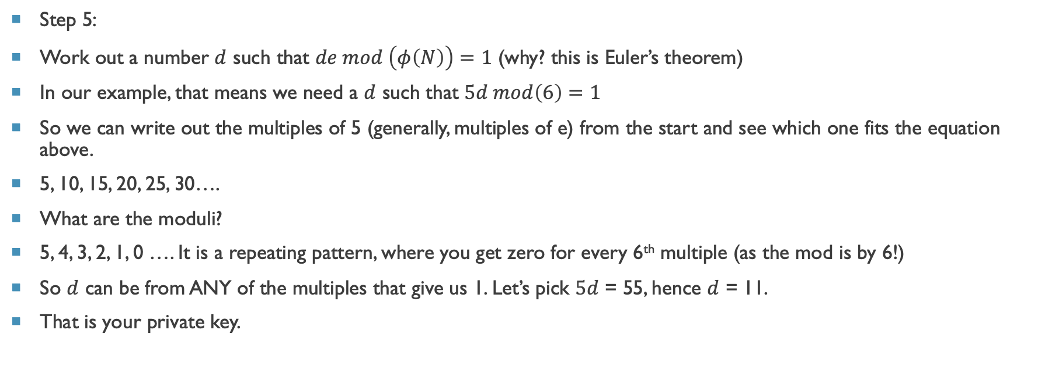
The rsa algorithm (part 2: private key generation)
Step 5:
Work out a number $d$ such that $de mod \left(φ\left(N\right)\right)=1$ (why? this is Euler’s theorem)
In our example, that means we need a $d$ such that $5d mod\left(6\right)=1$
So we can write out the multiples of 5 (generally, multiples of e) from the start and see which one fits the equation above.
5, 10, 15, 20, 25, 30….
What are the moduli?
5, 4, 3, 2, 1, 0 …. It is a repeating pattern, where you get zero for every 6th multiple (as the mod is by 6!)
So $d$ can be from ANY of the multiples that give us 1. Let’s pick $5d$ = 55, hence $d$ = 11.
That is your private key.
Notes:
Step 5: Now we need to work out a number d to use in the decryption formula.
Euler’s theorem basically links our phi function, which is our trapdoor function, with our private key calculation. We make the d dependent on the factors that are hard to know.
Choice of e in the previous step was also dictated by Euler’s theorem.
Note: investigate whether the choice of a particular d will make the encryption easier to break. (For instance, d = 5 would have made it too easy).

Slide 16
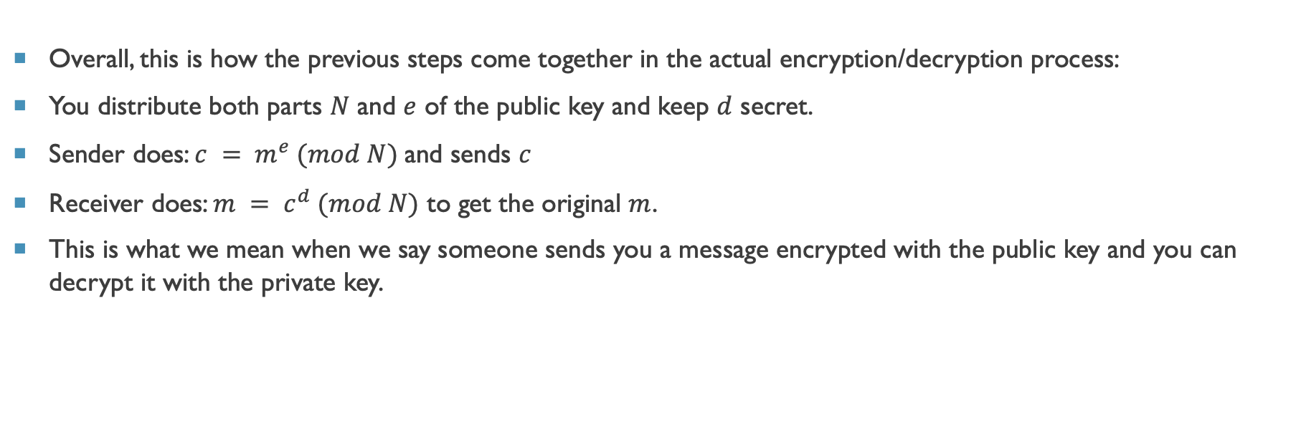
RSA: the big picture
Overall, this is how the previous steps come together in the actual encryption/decryption process:
You distribute both parts $N$ and $e$ of the public key and keep $d$ secret.
Sender does: $c = m^{e} (mod N)$and sends $c$
Receiver does: $m = c^{d} (mod N)$ to get the original $m$.
This is what we mean when we say someone sends you a message encrypted with the public key and you can decrypt it with the private key.

Slide 17
Over simplifications so far
How to convert m to a number?
How to calculate d?
Exponentiation of large numbers

Slide 18
Message Preprocessing
Each letter in the message is represented as its ASCII code number.
In ASCII, 'A' is coded as 65, 'B' is coded as 66 and so on.
The message "Secret!" is coded as: 83 101 99 114 101 116 33
Each ASCII code number is then represented in binary notation using 8 bits. For this example, the binary codes become:
01010011 01100101 01100011 01110010 01100101 01110100 00100001
18
Notes:
18

Slide 19
Message Preprocessing
Each pair of characters is then assembled into blocks.
This is done by taking two 8 bit numbers and representing them side by side as one 16 bit number.
In this example, there are 7 original characters that form 4 blocks (with padding):
0101001101100101
0110001101110010
0110010101110100
0000000000100001 Real applications of RSA use blocks of up to 8 or 16 characters each (64 or 128 bits in length).
Each message block is then represented as a decimal number that will be encrypted. For this example, the code blocks in decimal are: 21349 25458 25972 33
19
Notes:
19

Slide 20
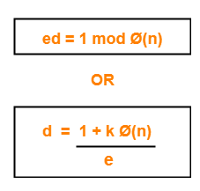
Calculating d
Either use Euler’s theorem’s derived form:
Or, the Extended Euclidean Algorithm

Slide 21
RSA: Fast Exponentiation
13 ^ 7 mod 33
a = bc mod n = (b mod n).(c mod n) mod n
Note that any number can be expressed as a sum of powers of 2.
m' = 13⁷ mod 33
= 13⁽⁴⁺²⁺¹⁾ mod 33
= 13⁴.13².13¹ mod 33
= 16 .4 . 13 mod 33
= 7 mod 33
13² = 169 ≡ 4 , 13⁴ = 4.4 = 16, 13⁸ = 16.16 = 256 ≡ 25.
21
Notes:
21
Great article that explains the above process well:
https://www.khanacademy.org/computing/computer-science/cryptography/modarithmetic/a/fast-modular-exponentiation

Slide 22

Key sharing: Diffie hellman key exchange

Slide 23
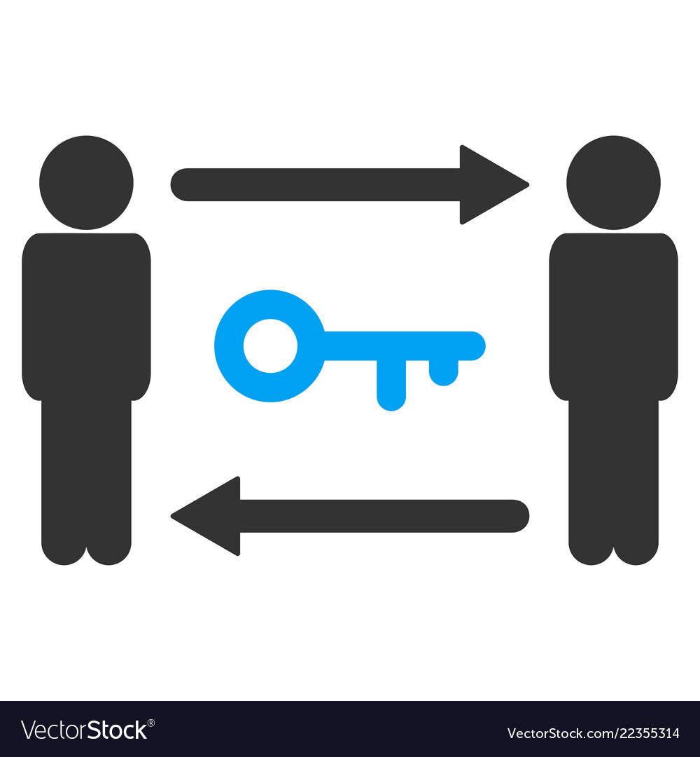
Diffie-Hellman Key Exchange
Allows group of users to agree on secret key over insecure channel
Numbers are exchanged in plain-text without encryption
Even if intruder gets the numbers, they won't be able to know the key
Security depends on the difficulty of computing “Discrete logarithms”
23
Notes:
23

Slide 24
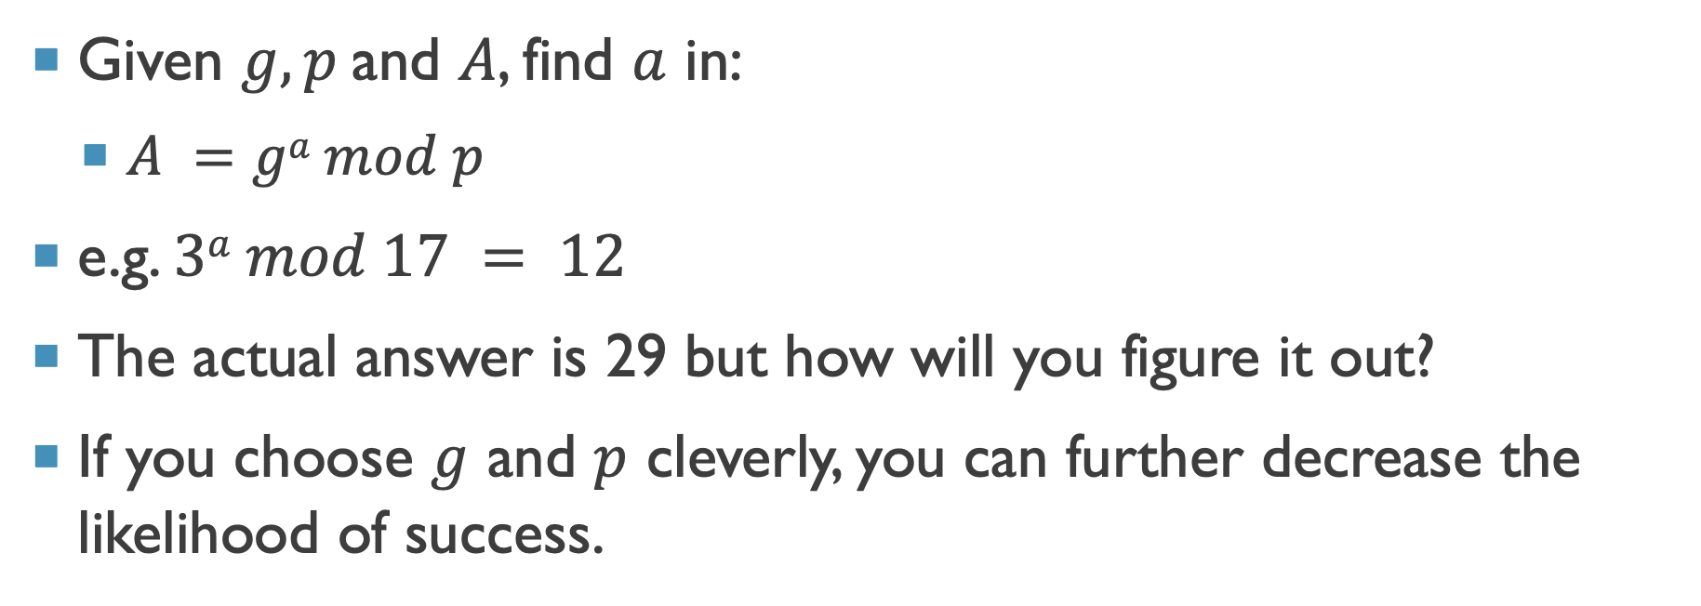
The discrete log problem
Given $g, p$and $A$, find $a$ in:
$A =ga mod p$
e.g. $3a mod 17 = 12$
The actual answer is 29 but how will you figure it out?
If you choose $g$ and $p$ cleverly, you can further decrease the likelihood of success.

Slide 25
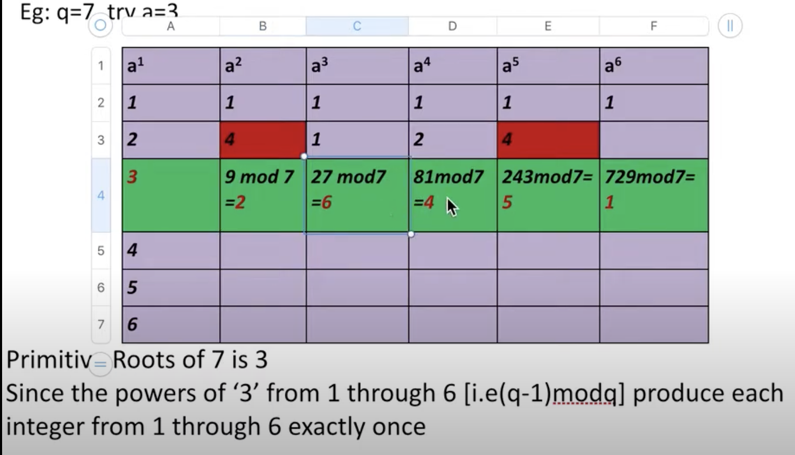
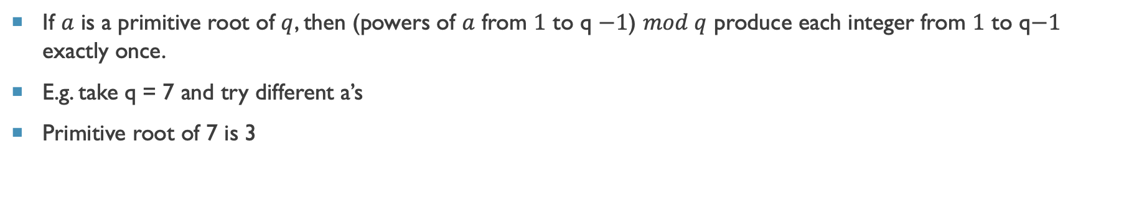
Primitive root
If $a$ is a primitive root of $q$, then (powers of $a$ from $1$ to q $−1$) $mod q$ produce each integer from $1$ to q$−1$ exactly once.
E.g. take q = 7 and try different a’s
Primitive root of 7 is 3
Notes:
Source of image: https://www.youtube.com/watch?v=kKTVB-_Z0GI

Slide 26
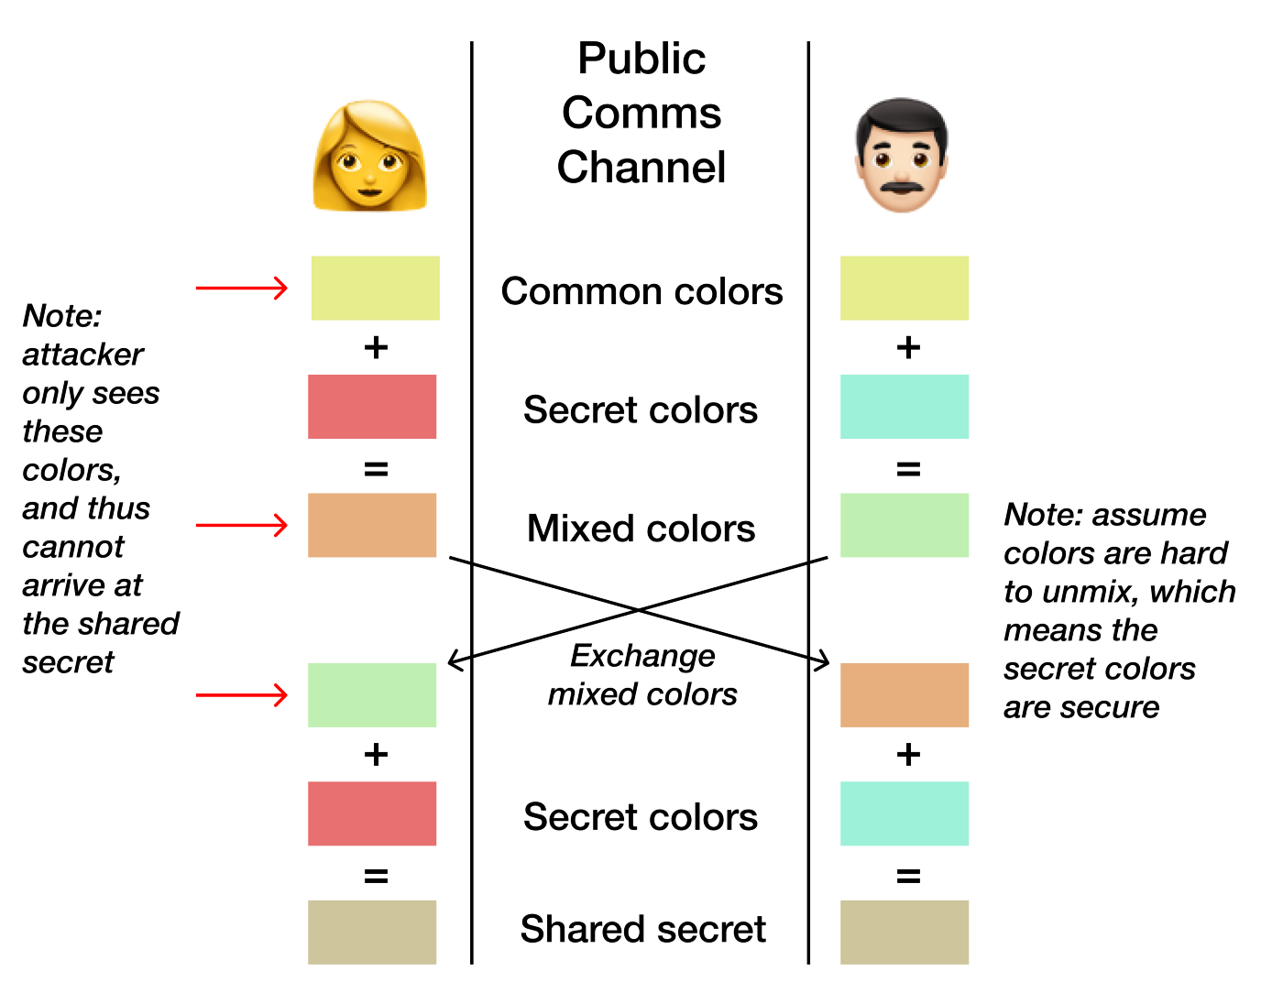
Diffie-Hellman Key Exchange: color analogy

Slide 27
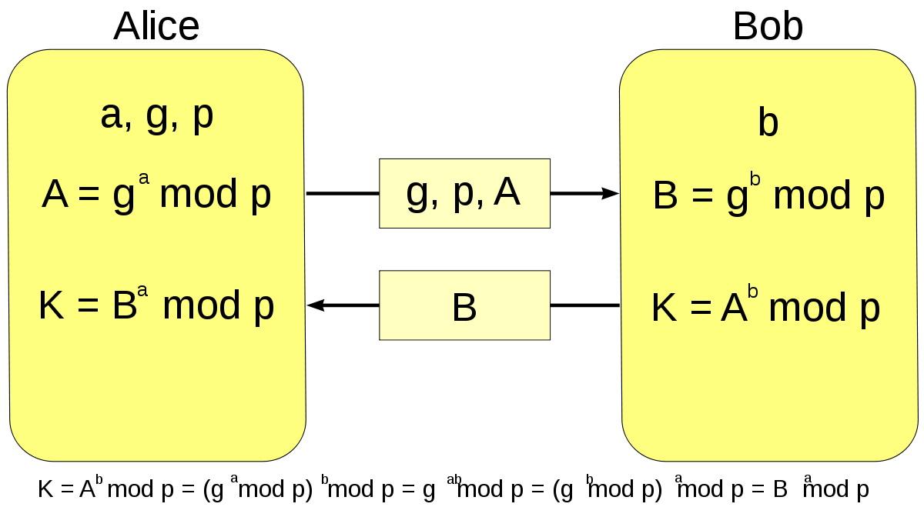
Diffie-Hellman Key Exchange
Alice and Bob want to agree on a secret key
They agree on two numbers g and p
Alice chooses a random number a and computes A
A=gª mod p and sends A to Bob
Bob chooses a random number b and computes B
B=g^{b} mod p and sends B to Alice
Alice computes S₁= Bª mod p
Bob computes S₂ = A^{b} mod p
S₁=S₂=g^{ab} mod p
Secret key is same (K in the image)
Notes:
Image source: https://upload.wikimedia.org/wikipedia/commons/thumb/1/13/Diffie-Hellman-Schl%C3%BCsselaustausch.svg/1200px-Diffie-Hellman-Schl%C3%BCsselaustausch.svg.png

Slide 28
Breaking down the math
Why did they end up with the same key?
Here’s what Alice did:
Bª mod p = (g^{b} mod p)ª mod p
Principle of modular arithmetic:
(a mod c)^{b} mod c = a^{b} mod c
Hence, Alice actually did g^{ba} mod p
Here’s what Bob did:
A^{b} mod p = (gª mod p)^{b} mod p
By the same principle, Bob actually did g^{ab} mod p
Which is the same as g^{ba} mod p
Hence they arrived at the same secret key!

Slide 29
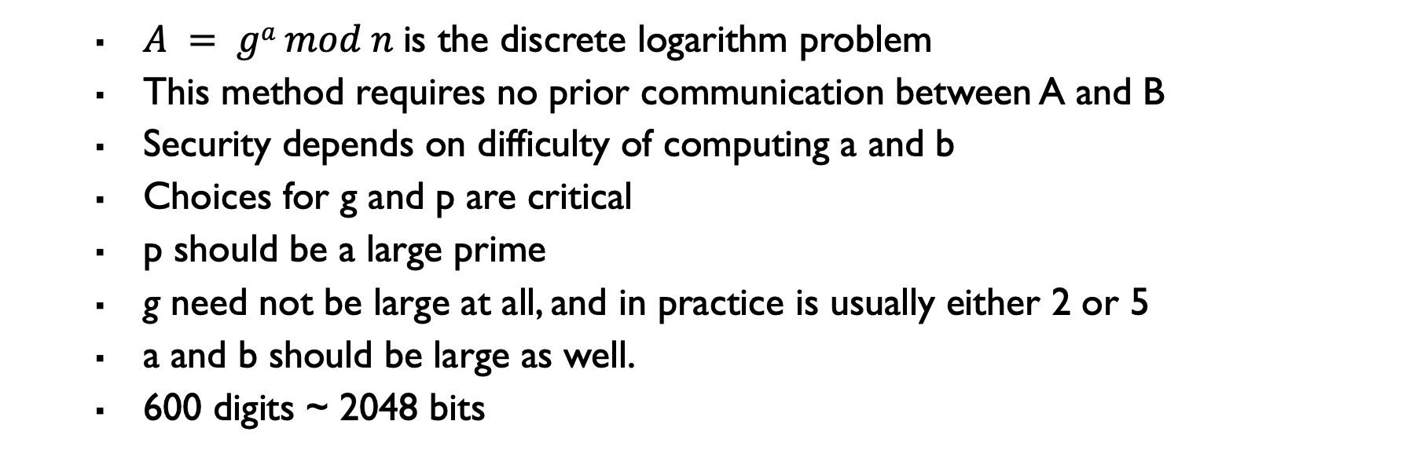
Diffie-Hellman Key Exchange
$A = ga mod n$is the discrete logarithm problem
This method requires no prior communication between A and B
Security depends on difficulty of computing a and b
Choices for g and p are critical
p should be a large prime
g need not be large at all, and in practice is usually either 2 or 5
a and b should be large as well.
600 digits ~ 2048 bits
29
Notes:
29

Slide 30
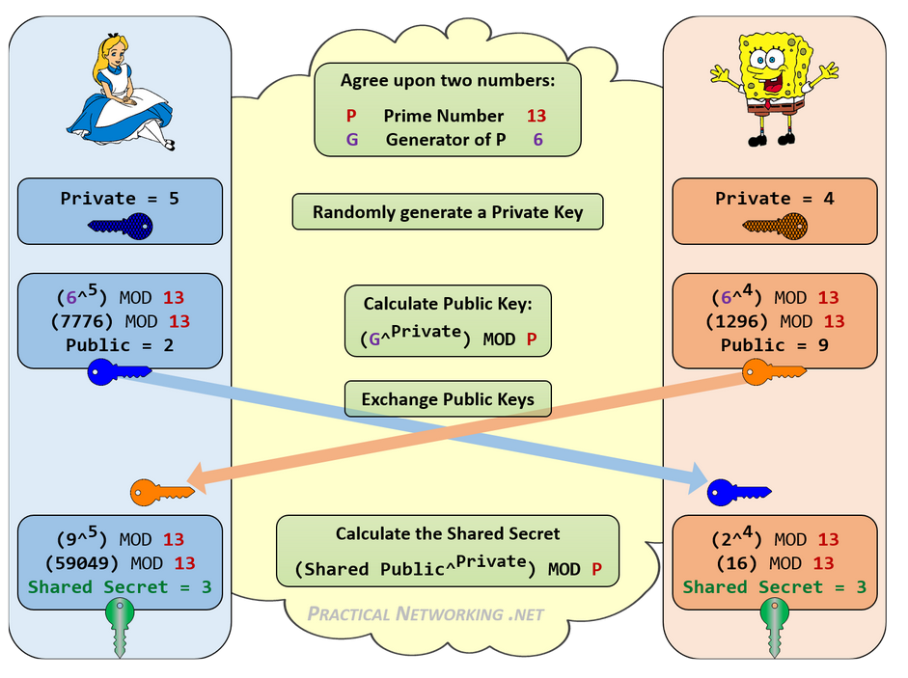
Remember p actually very large number!
So are a and b!

Slide 31
Solve this!
Example: g=5, p=17
Suppose Alice selects a=4
Suppose Bob selects b=2
Find the common key

Slide 32
Solution
g=5, p=17 (remember p actually very large )
Suppose Alice selects a=4 and computes A= 5^4 mod 17= 13 and sends to Bob
Suppose Bob selects b=2 and computes B=5^2 mod 17=8 and send to Alice
Alice calculates 8^4 mod 17 = 16
Bob calculates 13^2 mod 17= 16, The common key

Slide 33
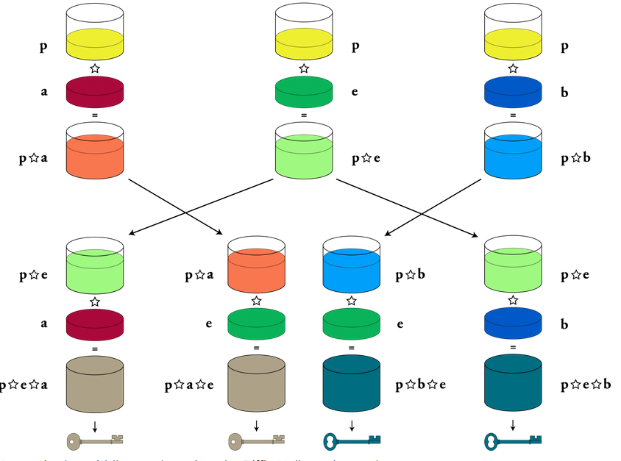
Man in the Middle Attack
Alice Eve Bob
Notes:
https://open.oregonstate.education/defenddissent/chapter/the-man-in-the-middle/

Slide 34
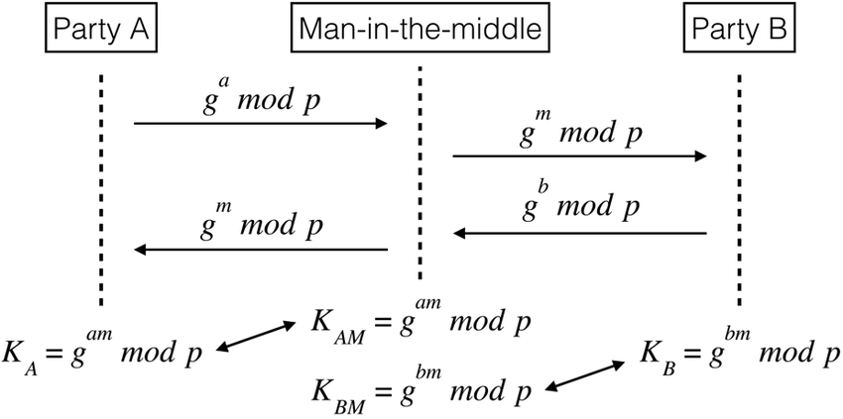
Man in the Middle Attack
Notes:
https://open.oregonstate.education/defenddissent/chapter/the-man-in-the-middle/

Slide 35
Solution of the man in the middle attack?
Authentication!

Slide 36
Public key infrastructure

Slide 37
Public Key Distribution
In asymmetric-key cryptography, people do not need to know a symmetric shared key
Everyone shields a private key and advertises a public key.
Public keys need to be distributed to be useful.
37
Notes:
37

Slide 38
Public Key Distribution
Public Announcement:
A naïve approach is to announce public keys publicly
Bob can put his public key on his website or even an announce it in local or national newspaper or give it to anybody who requests for it.
Approach is not secure as it is subject to forgery
Eve could make such a public announcement and before Bob reacts the damage is done
Eve can fool Alice to sending her message or can also sign a document with a corresponding forged private key and make everyone believe that it was signed by Bob.
In case of direct request as well, Eve can intercept and send Alice her own forged key
38
Notes:
38

Slide 39
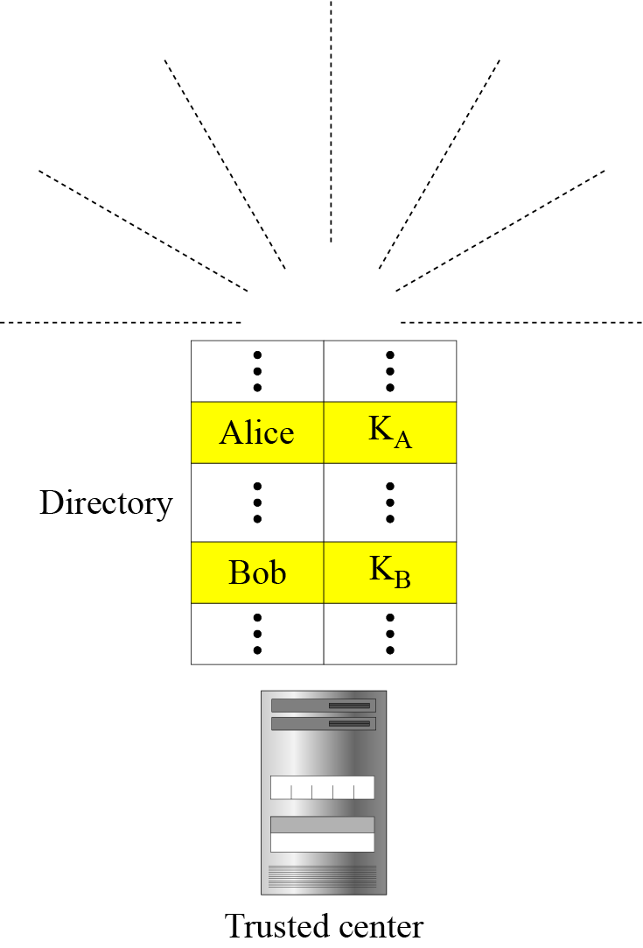
Public Key Distribution
Trusted Center:
Better approach is to have a trusted center retain a directory of public keys and the directory is dynamically updated
Each user can select a private and public key. Keep the private key, and deliver the public key for insertion into the directory
Center requires that each user register in the center and prove his or her identity
Directory can be publicly advertised by the trusted center and can and center can also respond to any inquiry about a public key
39
Notes:
39
Security issues with this?
What if someone intercepts communication with directory and responds to an inquiry with a fake public key (e.g. attacker’s)
What if the center revoked a key but owner pretends it is valid and people still use it (without asking the center, say sender had already stored it in their local database)

Slide 40
Public Key Distribution
Controlled Trusted Center:
A higher level of security can be achieved if there are added controls on the distribution of the public key
The public key announcements can include a timestamp and be signed by an authority to prevent interception and modification of the response
If Alice needs to know Bob’s public key, she can send a request to the center including Bob’s name and a timestamp
The center responds with Bob’s public key, the original request, and the timestamp signed with the private key of the center
Alice uses the public key of the center, known by all, to verify timestamp
If the timestamp is verified, she extracts Bob’s public key
40
Notes:
40

Slide 41
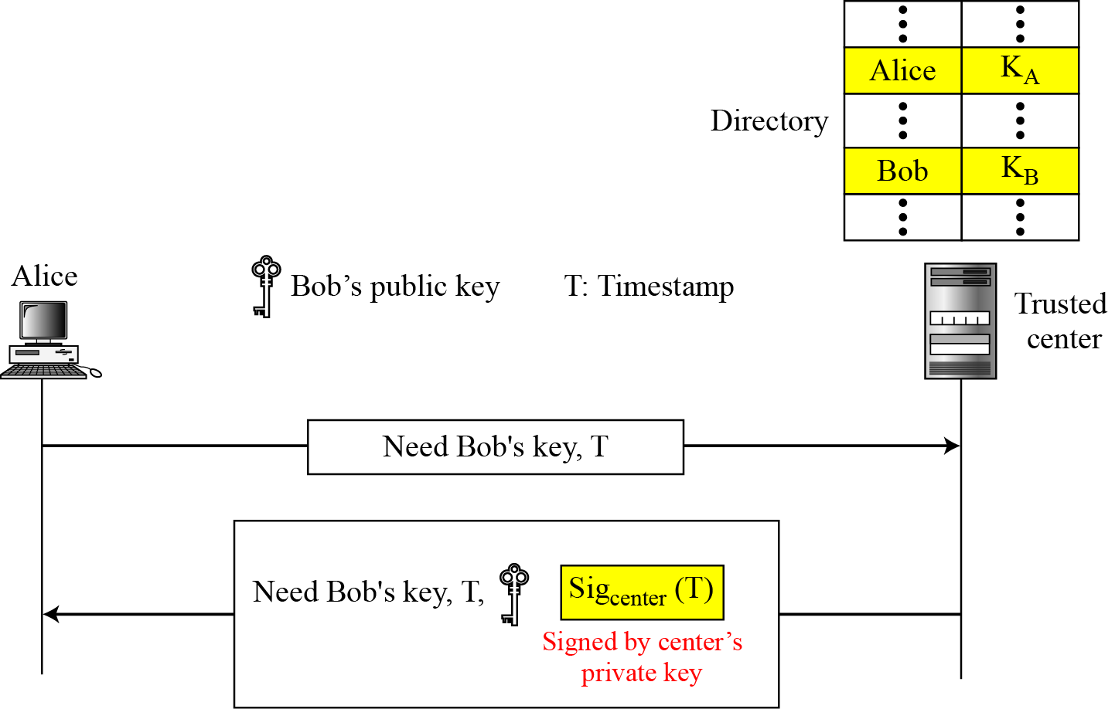
Public Key Distribution
Controlled Trusted Center:
41
Notes:
41

Slide 42
Public Key Distribution
Certification Authority:
Previous approach can create a heavy load on the center if the number of requests is large
Alternative is to create Public-Key certificates
Bob wants two things
He wants people to know his public key
He want no one to accept a forged public key as his
Bob can go to a certification authority, a federal or state organization that binds a public key to an entity and issues a certificate
The CA has a well-known public key itself that cannot be forged
CA checks Bob’s identification(picture ID and proof) and asks Bob’s public key and writes it on the certificate.
42
Notes:
42

Slide 43
Public Key Distribution
Certification Authority:
To prevent the certificate itself from being forged, the CA signs the certificate with its private key
Now Bob can upload the signed certificate
Anyone who wants Bob’s public key downloads the signed certificate and uses the center’s public key to extract Bob’s public key.
43
Notes:
43

Slide 44
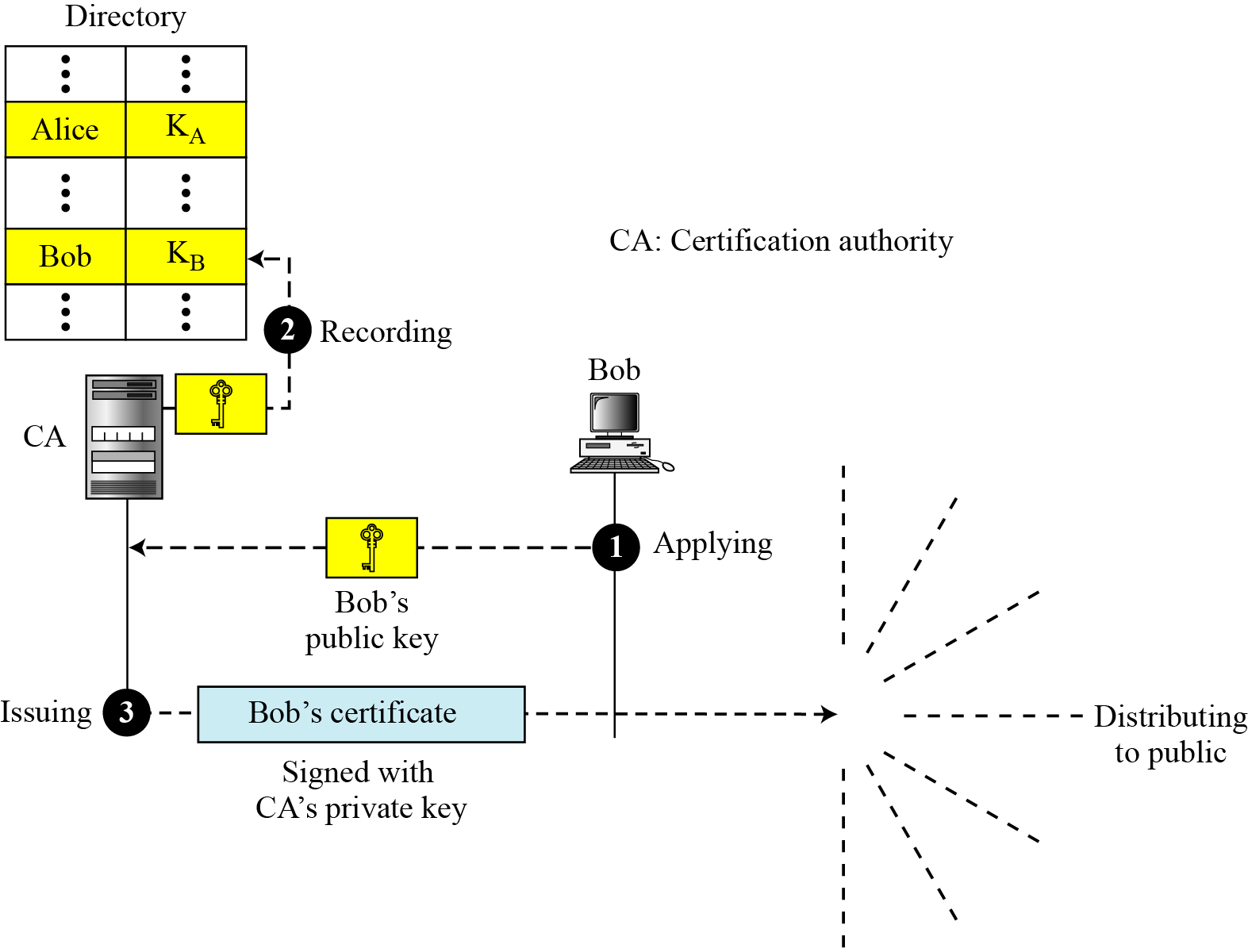
Public Key Distribution
44
Notes:
44

Slide 45
Public Key Distribution
Certification Authority in Pakistan:
The most common use of certificates is for HTTPS-based web sites, usually used for E-commerce.
One of the major CA working in Pakistan is National Institutional Facilitation Technologies (NIFT) formed in early 1995 is working as partner with VeriSign and share VeriSign CA services.
PKGRID-CA, owned by National Center of Physics (Quaid-i-Azam University), issues X.509 digital certificates to use grid resources under secure environment.
It is serving over 10,000 Pakistani scientists all around the world.
VeriSign and Microsoft are the giants in Certification Authorities worldwide.
Verisign’s Authentication business has been sold to Symantec.
45
Notes:
45

Slide 46
Public Key Distribution
X.509:
The use of a CA has solved the problem of public-key fraud but has created a side-effect
Each certificate may have a different format
If Alice wants to use a program to automatically download different certificates and digest belonging to different people, the program may not be able to do this
One certificate may have the public key in one format and another in a different format
The public key may be on the first line in one certificate and on the third line in another
X.509 has been designed to remove this side-effect
46
Notes:
46

Slide 47
Public Key Distribution
X.509:
X.509 is a way to describe the certificate in a structred way
Uses a well-known protocol called ASN.1 (Abstract Syntax Notation 1) that defines fields familiar to C programmers
Certificate:
A certificate has following fields
Version number: defines the version of X.509 of the certificate. Started with 0, the current version is 2 (third version)
Serial number: defines a number assigned to each certificate. Unique for each certificate issuer.
Signature Algorithm ID: identifies the algorithm used to sign the certificate. Any parameter needed for the signature is also defined in this field.
47
Notes:
47
Standards contain technical specifications or other precise criteria designed to be used consistently as a rule, guideline, or definition. They help to make life simpler and increase the reliability and the effectiveness of many of the goods and services we use.

Slide 48
Public Key Distribution
X.509:
Certificate:
Issuer name: identifies the certification authrotiy that issued the certificate. Normally a hierarchy of strings that defines a country, state, organization, department and so on
Validity Period: defines the date duration in which the certificate is valid
Subject name: defines the entity to which the public key belongs
Subject public key: defines the owner’s public key
Issuer unique Identifier: This optional field allows two issuers to have the same issuer field value, if the issuer unique identifiers are different.
48
Notes:
48

Slide 49
Public Key Distribution
X.509:
Certificate:
Subject unique Identifier: Optional field Allows two different subjects to have the same subject field value, if the subject unique identifiers are different.
Extensions: Optional field, allows issuers to add more private information to the certificate
Signature: contains the digest of the first section signed by the CA private key
49
Notes:
49

Slide 50
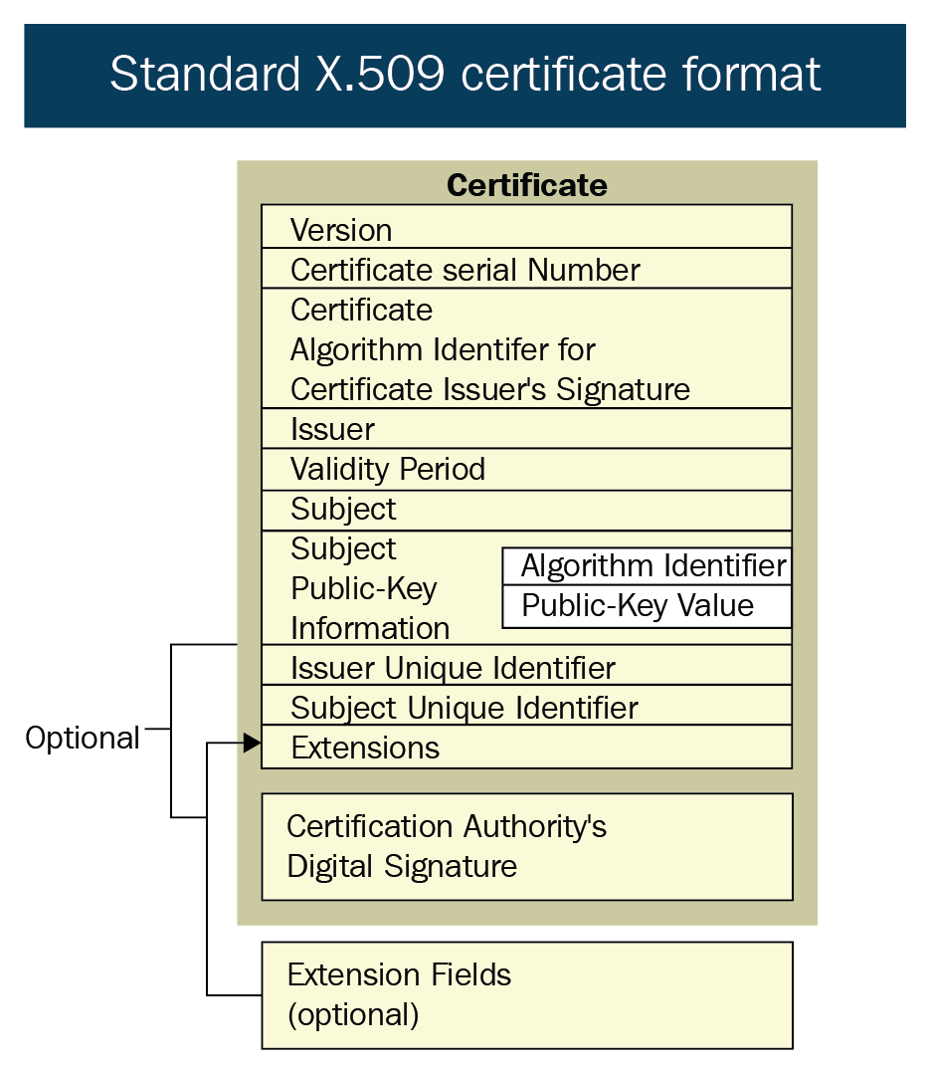
50
Notes:
50

Slide 51
Public Key Distribution
X.509:
Certificate Renewal
Each certificate has a period of validity. If there is no problem with the certificate, the CA issues a new certificate before the old one expires.
Certificate Revocation
In some cases a certificate must be revoked before its expiration like
The user’s private key might have been compromised
The CA is no longer willing to certify the user (user certificate relates to an organization that she no longer works for)
The CA’s private key, which can verify certificates, may have been compromised. CA revokes all unexpired certificates
Revocation is done by periodically issuing a certificate revocation list(CRL)
51
Notes:
51

Slide 52
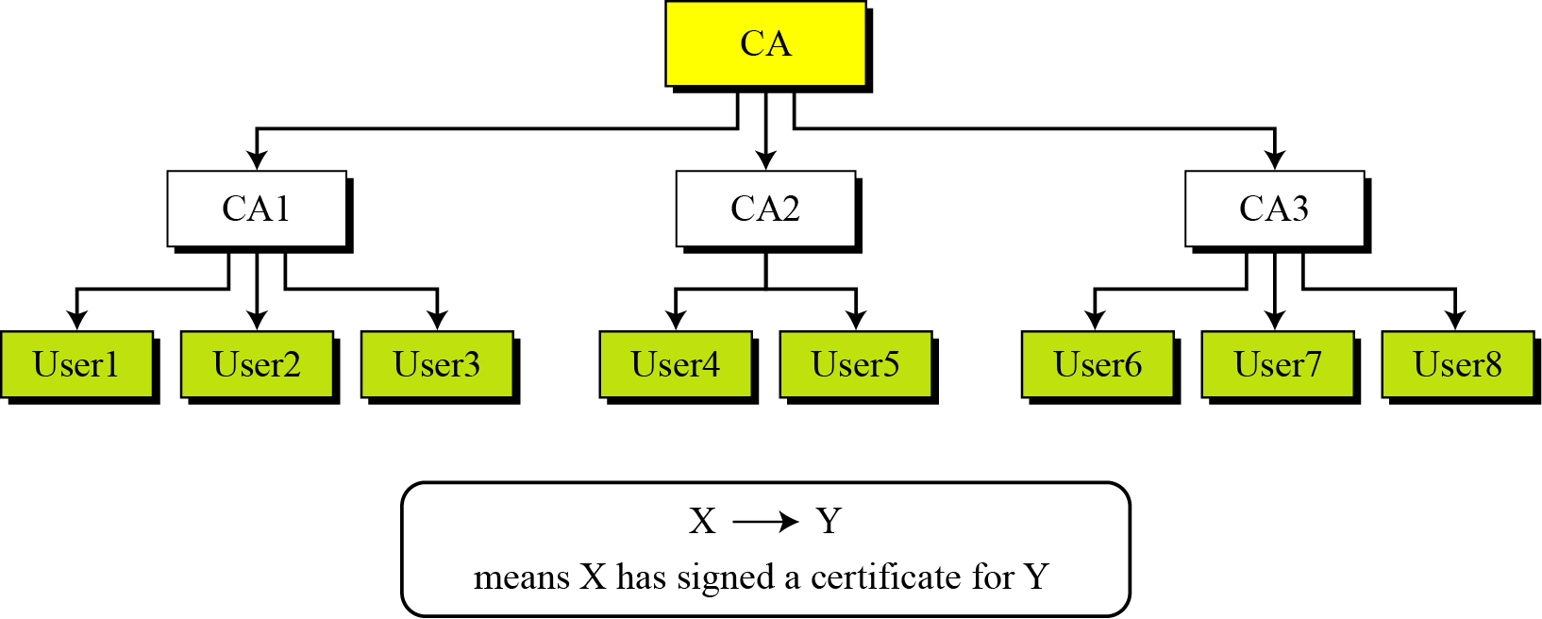
Public Key Infrastructures
Trust Model:
The number of levels can be more than three in a real situation.
The figure shows that the CA (the root) has signed certificates for CA1, CA2, and CA3; CA1 has signed certificates for User1, User2 and User3; and so on
PKI uses the following notation to mean the certificate issued by authority X for entity Y. X<<Y>>
52
Notes:
52

Slide 53
Public Key Infrastructures
Hierarchical Trust Model
Example: Show how User1, knowing only the public key of the CA (the root), can obtain a verified copy of User3’s public key.
Solution:
User3 sends a chain of certificates, CA1<<User3>> and CA<<CA1>> to User1.
User1 validates CA<<CA1>> using the public key of CA.
User1 extracts the public key of CA1 from CA<<CA1>>.
User1 validates CA1<<User3>> using the public key of CA1.
User1 extracts the public key of User 3 from CA1<<User3>>.
53
Notes:
53

Slide 54
Sources
Some of the slide material is borrowed from:
https://cpe.ku.ac.th/~nguan/class/204427-54/slides/01204427-AES.ppt
https://www.kavaliro.com/wp-content/uploads/2014/03/AES.pdf

